Slide 1
Scrap-Vend
TEAM MEMBERS
Mohammad Noman
Poornima Varshney
Aishwarya Phulwani
Saif Ali
Guided By:
Mrs. Rozy Verma

Slide 2
CONTENTS
Introduction
Modules Identified
Flow Graph of Modules
Logical Database
Technologies to be use
References

Slide 3
Introduction
The main purpose of this application is to ensure that all the scrap are managed in such a way that protects both public health and environment by providing an ease to the people so that they can also contribute in the cleanliness of the surroundings without working hard and spending much time.
We provide the service to collect scrap material from your location and sell it to the recycling companies with market rates to help both.

Slide 4
Modules Identified
Registration
Login
Item Details
Booking
Payment
Cancellation
Sale
Feedback

Slide 5
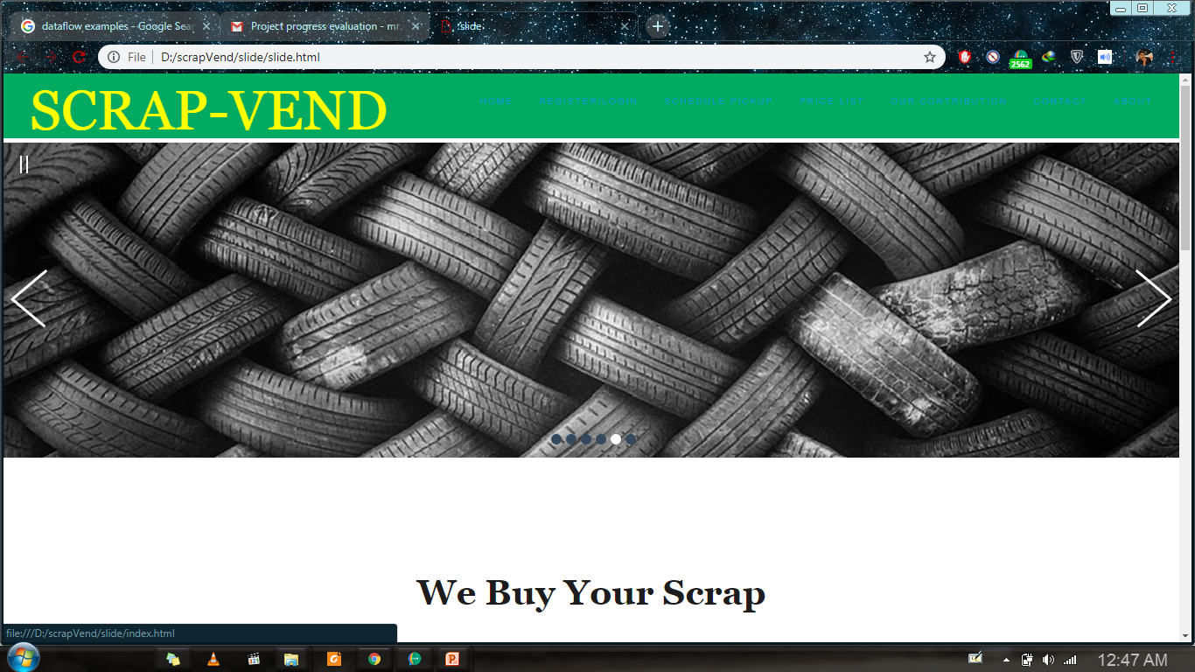
Flow Graph of Modules
Place your screenshot here
Home Page

Slide 6
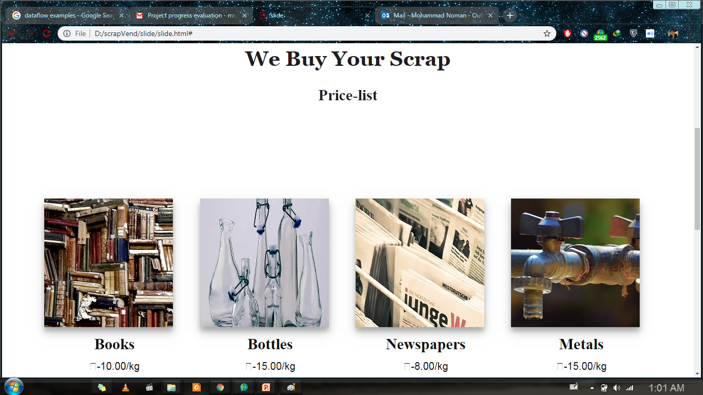
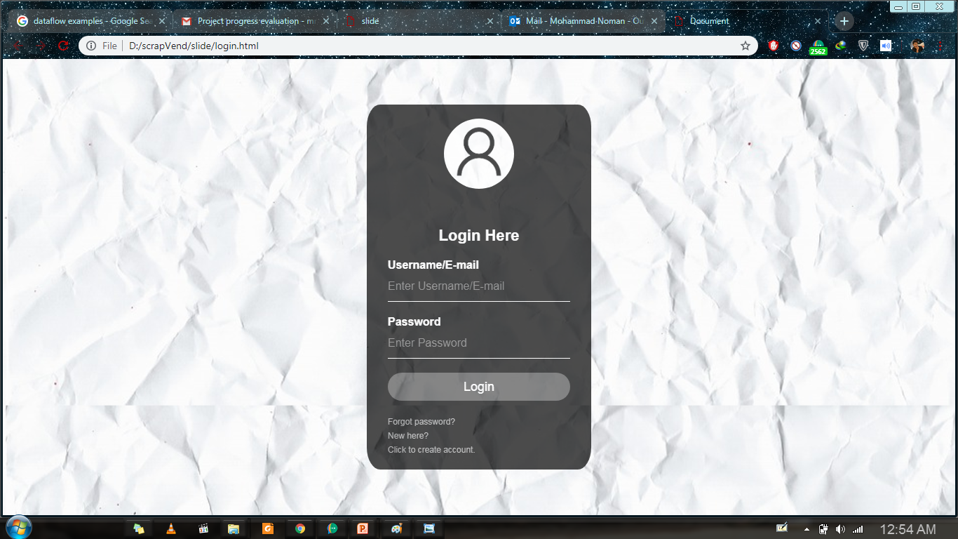
Item details
(Price List)
Place your screenshot here

Slide 7
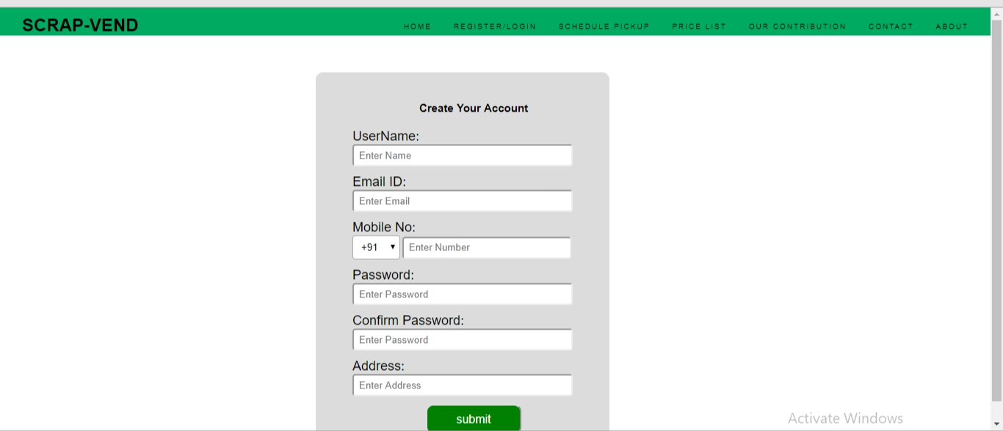
Registration
Place your screenshot here

Slide 8
Login Form
Place your screenshot here

Slide 9
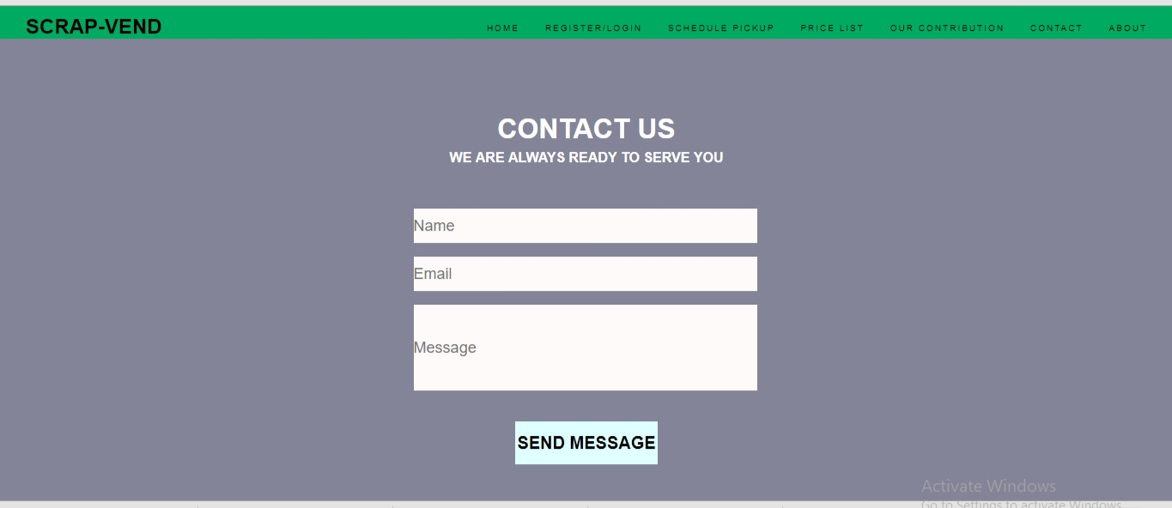
Contact us
Place your screenshot here

Slide 10
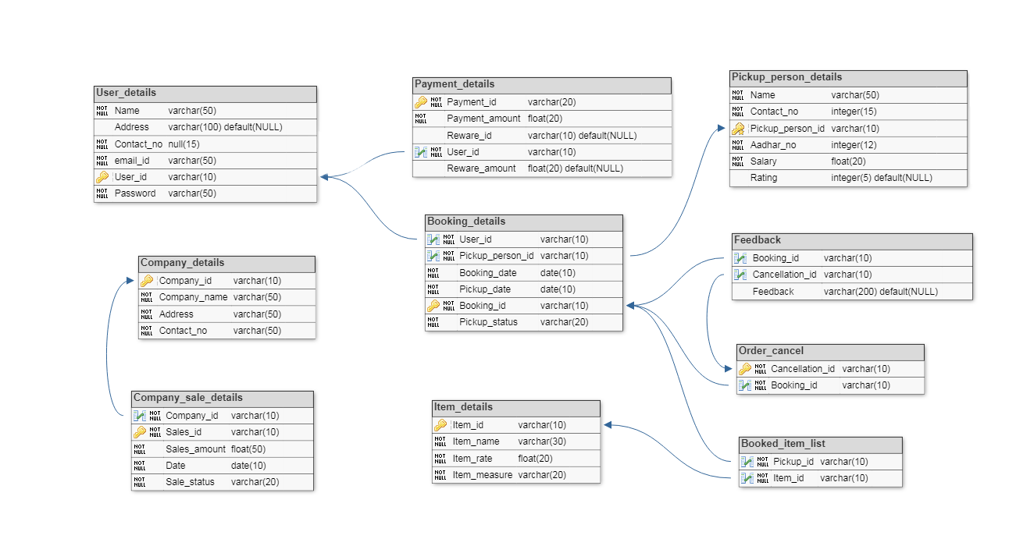
Logical Database

Slide 11
Technologies to be Use
HTML
CSS
JavaScript
Php
MySql

Slide 12
References
[1] https://www.Dbdesigner.net (Last accessed on 31/03/2019)
[2] https://www.comentum.com/guide-to-web-application-development.html (Last accessed on 01/04/2019)
[3] https://www.geeksforgeeks.org/html-tutorials/ (Last accessed on 31/03/2019)
[4] https://www.geeksforgeeks.org/css-tutorials/ (Last accessed on 31/03/2019)
[5] https://www.w3schools.com/html/default.asp (Last accessed on 31/03/2019)
[6] https://www.w3schools.com/css/default.asp (Last accessed on 31/03/2019)

